Slide 1
Forest Fire Predictive Analytics with AWS Cloud

Slide 2
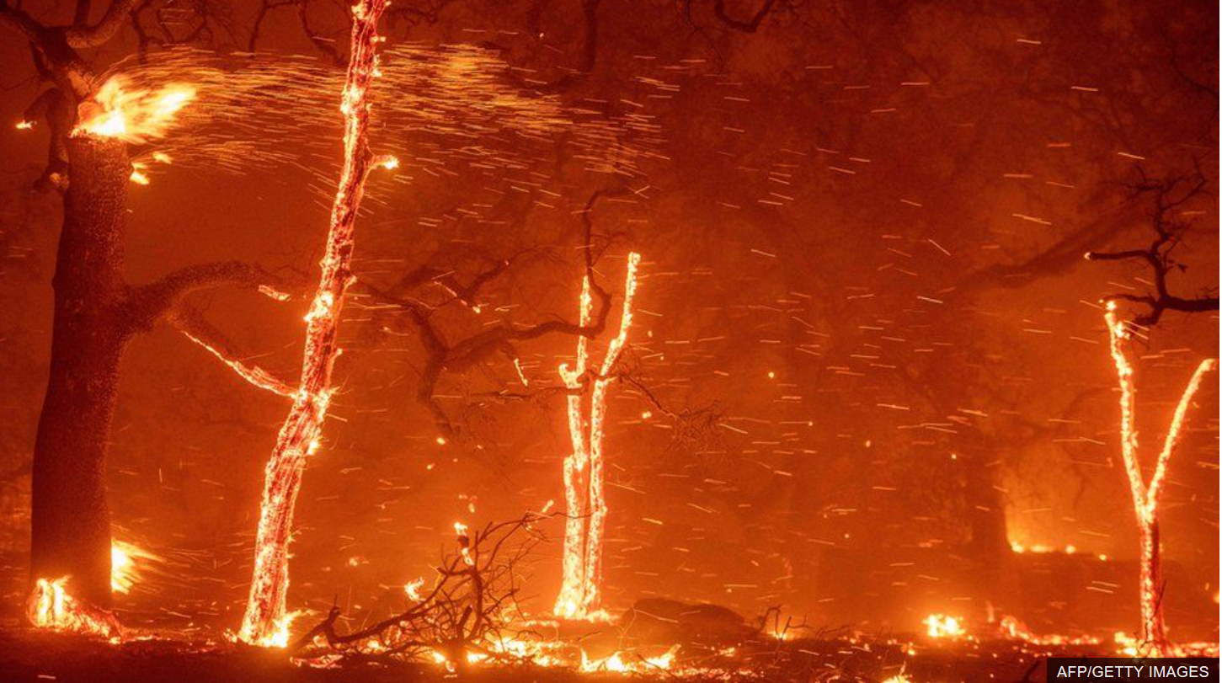
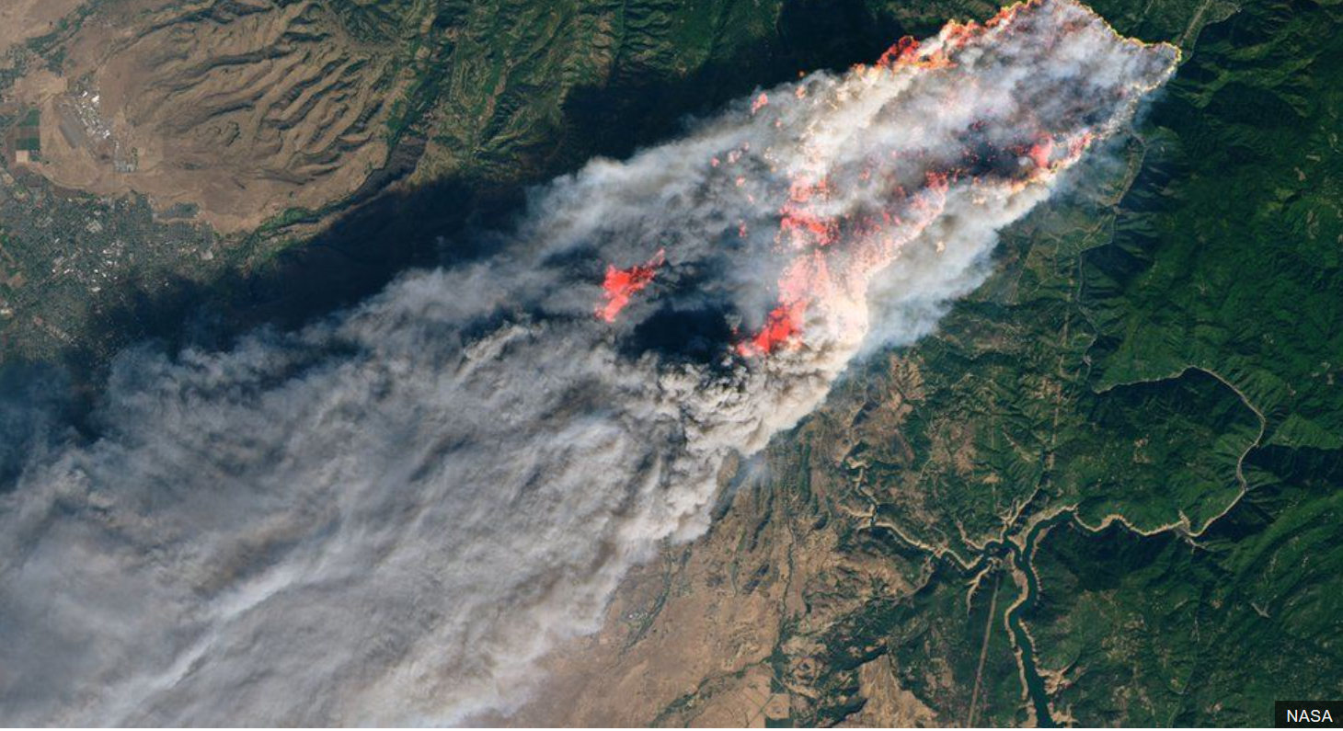
Background
Wildfires can cause much destruction and cost millions of dollars in damage.
Increase in severity and frequency of wildfires may be due to increased human development in wild/rural areas and climate change.
Ability to predict wildfires cause can help prevent and/or manage wildfires.
Enable fire scientists to quickly determine the cause of wildfire
Dataset:
www.kaggle.com/rtatman/188-million-us-wildfires

Slide 3
Features List
Predict cause of wildfire (Lightning, Smoking, etc.)
Provide data visualizations of wildfire
Provide a database to store historical wildfires that can be easily queried

Slide 4
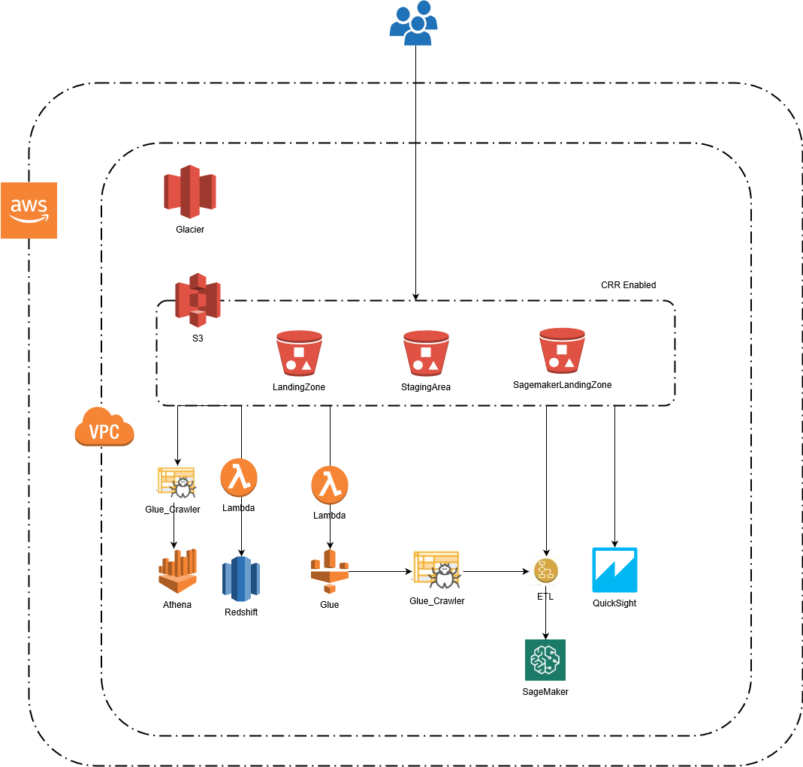
AWS Architecture
Technologies used:
Python + libraries SQL
AWS S3
AWS Glue
AWS Lambda
AWS Athena
AWS Redshift
AWS QuickSight
AWS SageMaker
AWS CloudWatch Logs

Slide 5
Step-by-Step
Upload the csv data file to s3://landing-zone1
The file is copied to the landing-zone-2 area bucket using CRR
SNS event is triggered which fires the lambda function
Lambda copies data into RedShift and triggers a Glue job
Glue starts the ETL job to apply mapping and place the file in its destination
Use the data to train and deploy model on SageMaker
Hit the SageMaker endpoint to predict the cause of wildfires
Use QuickSight to generate visualizations from S3 data
Query the data using Athena

Slide 6
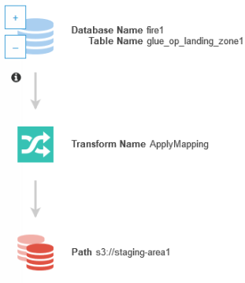
AWS Glue
Crawler: reads metadata from /landing-zone1/
ETL job: reduces the dataset and stores in /staging-area1/
Type: Spark (10 DPU)

Slide 7

RedShift
Stores historic data
Lambda copies(appends) data into it
Data can be queried using a SQL client

Slide 8
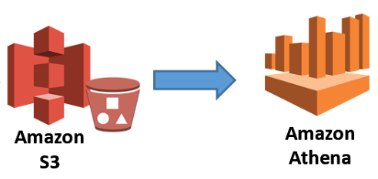
AWS Athena
Used for querying data from S3 bucket using SQL queries

Slide 9
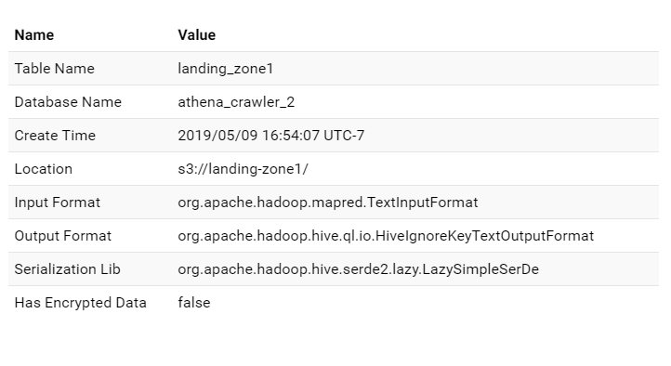
AWS Athena
Used a crawler to create a table from landing zone 1

Slide 10
Dataset Overview - Selected Features
FIRE_YEAR: long | LONGITUDE: double
STAT_CAUSE_DESCR: string | STATE: string
FIRE_SIZE: double | COUNTY: long
LATITUDE: double | DISCOVERY_DATE: double

Slide 11

AWS SageMaker
Used SageMaker Python SDK
Session: Provides a collection of methods for working with SageMaker resources.
SKLearn Estimator: Encapsulate training on SageMaker.
Trained SKLearn Estimator (i.e. Random Forest Classifier)
Using SageMaker notebook instances, trained SageMaker Estimator
Deploy model as SageMaker endpoint for a hosted machine learning solution
CloudWatch for Debugging and Monitoring

Slide 12
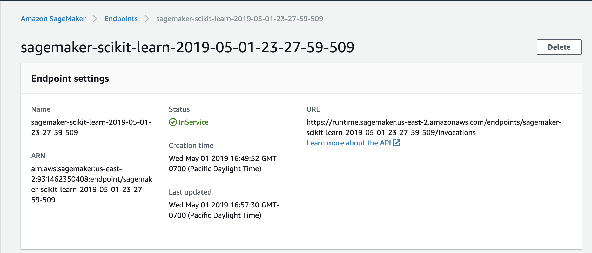
AWS SageMaker Screenshots

Slide 13
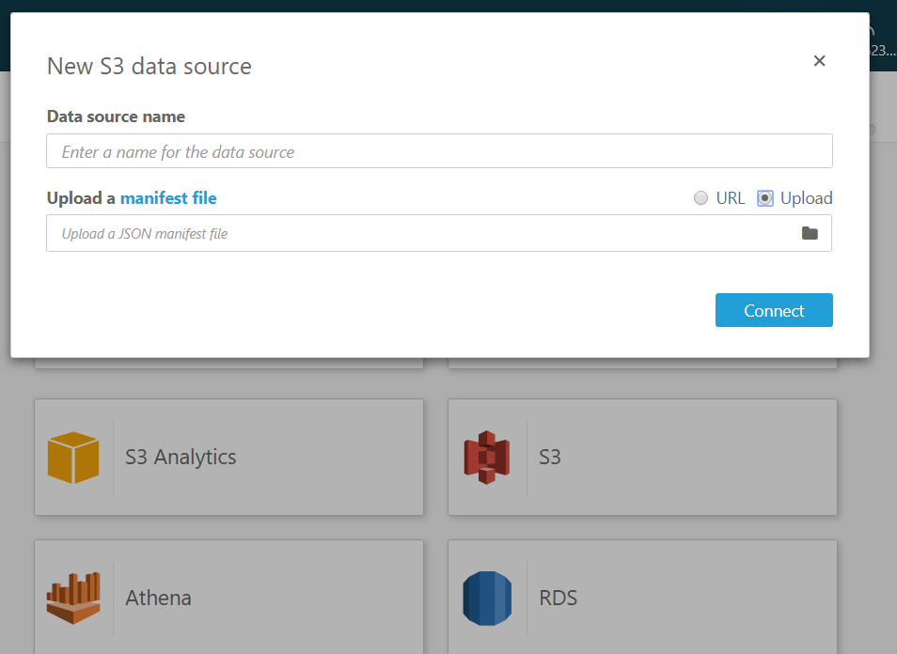
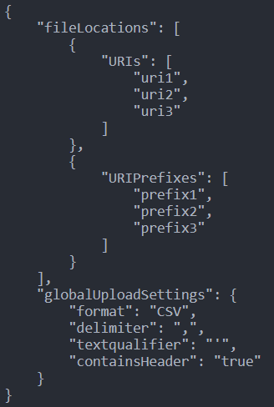
Connect an S3 bucket to QuickSight
Manifest JSON template

Slide 14
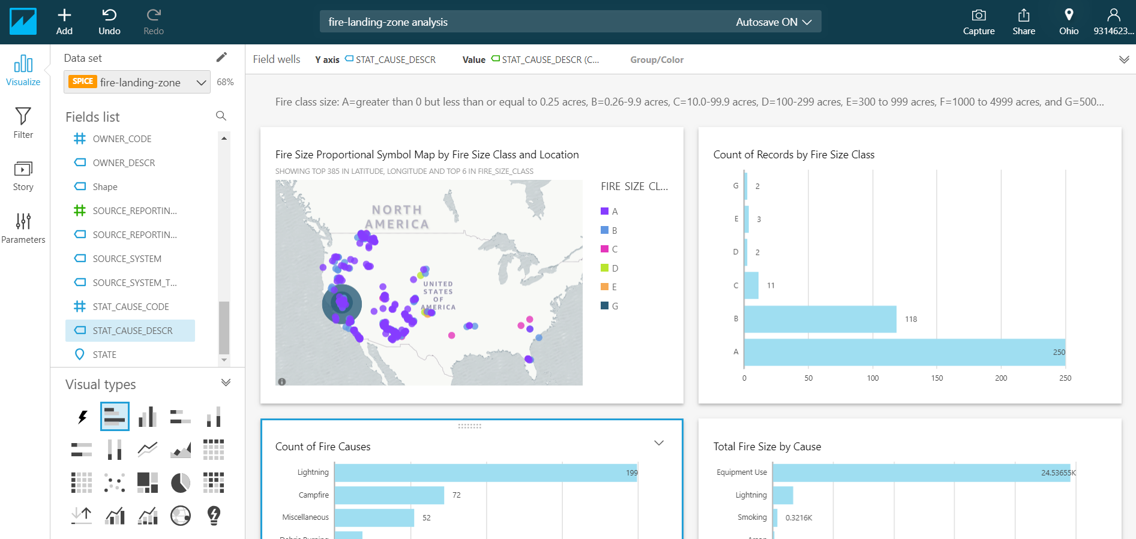
QuickSight Analysis to create visualizations

Slide 15
Conclusion
Future Scope:
Online Training (i.e. training on the fly for data as it comes in)
Predict fire size of a wildfire
Creating a UI for end users

Slide 16
Thank You!

